Slide 1
DIALYZER
PRESENTED BY
NANDHINI.M
PARKAVI .G

Slide 2
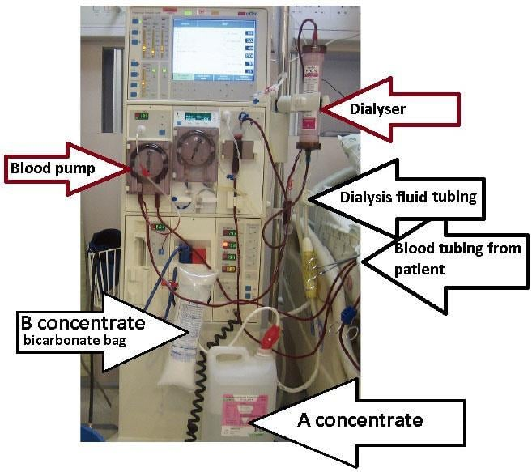
DIALYZER
It works like an artificial kidney.
A dialyzer is a medical device used in dialysis.
It removes waste and extra water from blood.
It is used when kidneys stop working properly.

Slide 3
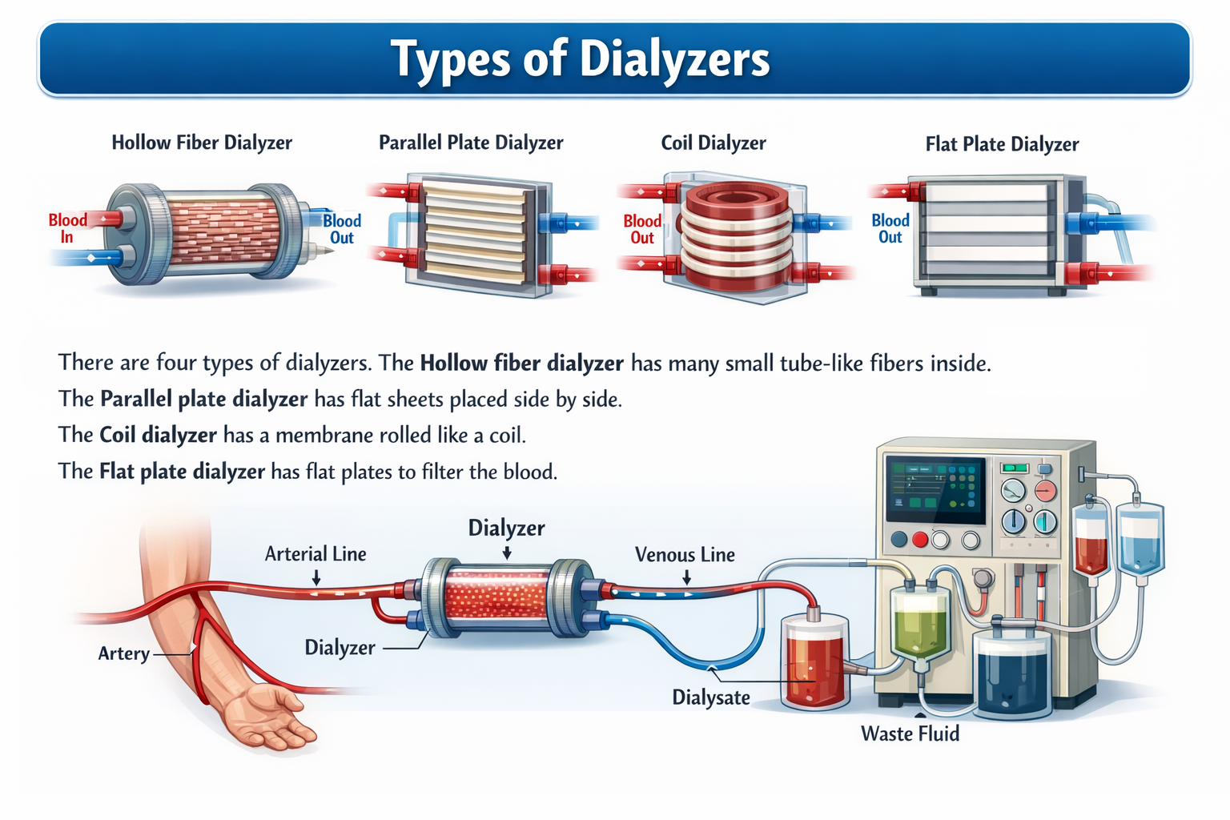
TYPES OF DIALYZER
Coil dialyzer
Flat plate dialyzer
Hollow fiber dialyzer
Parallel plate dialyzer

Slide 4
INVENTOR OF DIALYZER
Father of the Artificial Kidney
Year of invention: 1943
Place of research: University of Groningen in Netherland
Inventor: Dr. Willem Kolff

Slide 5
USES OF DIALYZER
Treatment of kidney failure – Acts as an artificial kidney.
Removal of waste products – Removes harmful wastes from the blood.
Removal of excess fluid – Eliminates extra water from the body.
Correction of electrolyte imbalance – Maintains proper mineral levels in the blood.

Slide 6
THANK YOU

